Slide 1
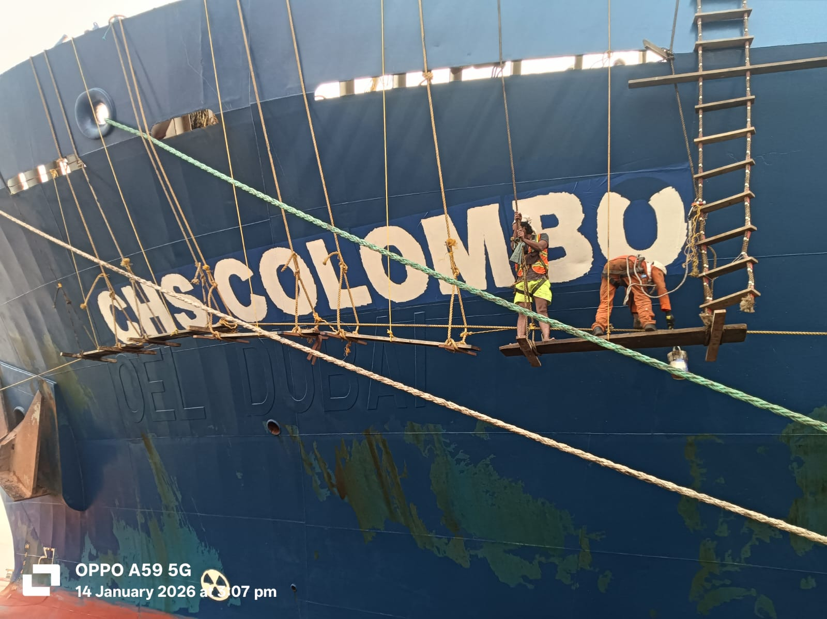
TMB SHIPPING PVT LTD
B-6,Garden Reach Road, Kolkata - 700024, INDIA
visit us at : www.tmbindia.com
contact us at : tmbshipping@gmail.com
call us at : +91 98310 18661 ( MD) / +91 98311 93933
m.v. CHS Colombo Maintenance & Repair Project at Kolkata Port
Comprehensive maintenance and repair operations conducted across multiple periods from November 2025 through January 2026. This presentation documents critical work performed on water ballast systems, deck structures, painting operations, and safety equipment installations.

Slide 2
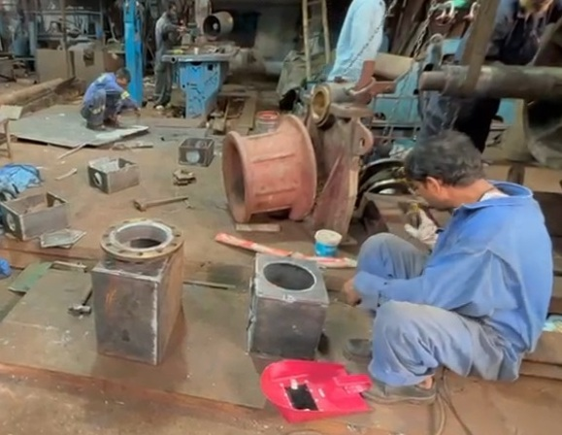
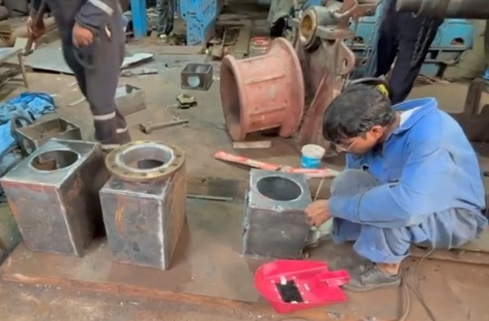
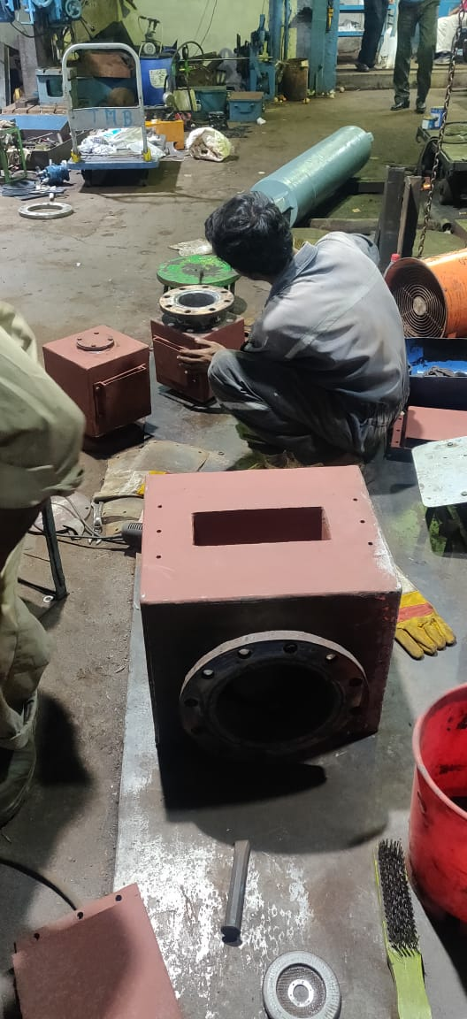
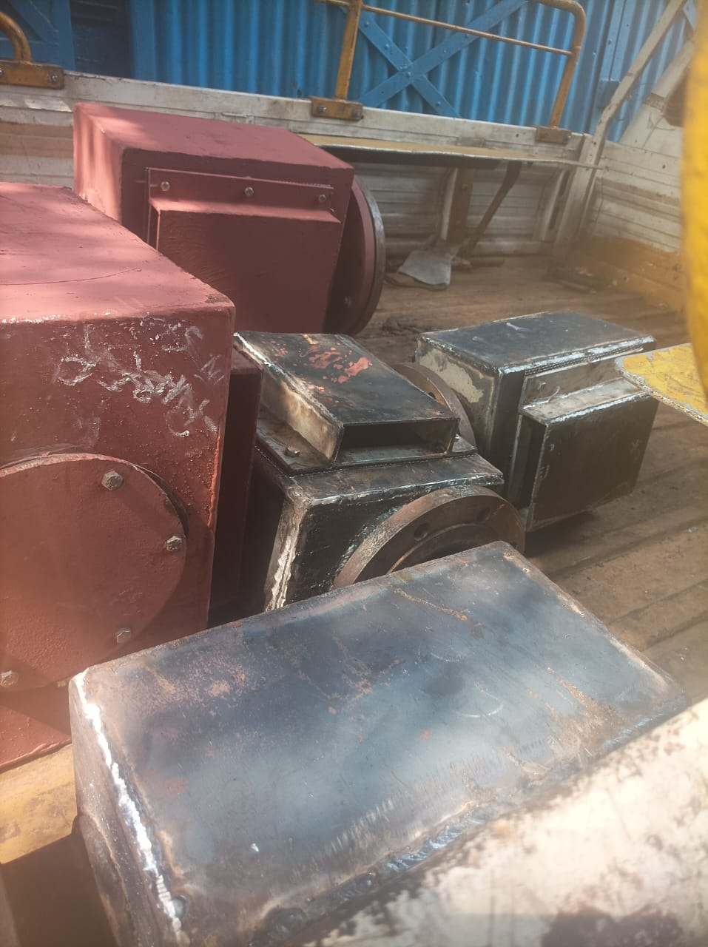
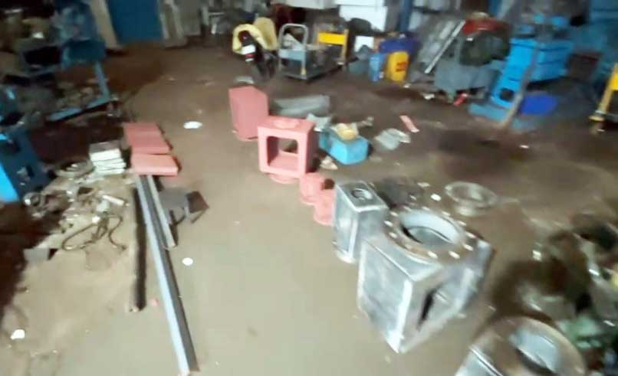
NOVEMBER 16-18, 2025
Water Ballast Tank Ventilation System Overhaul
Complete fabrication and installation of air vent heads and mushroom vents for water ballast tanks. All components manufactured at workshop using supplied materials, including flanges, flaps, SS wire-mesh, rubber seals, SS bolt-nuts, rubber joints, and floating balls.

Slide 3
Air Vent Head Fabrication Summary
9
4
2
20
125 NB Sets
200 NB Sets
125 NB Sets
Face Plates
First batch fabricated and supplied
Fabricated, supplied, and fitted
Additional units fabricated
365 x 325 mm dimensions

Slide 4
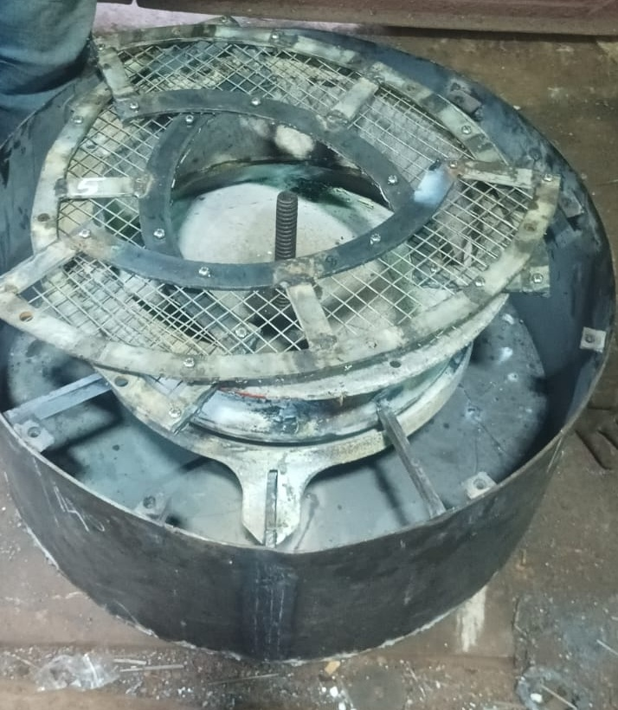
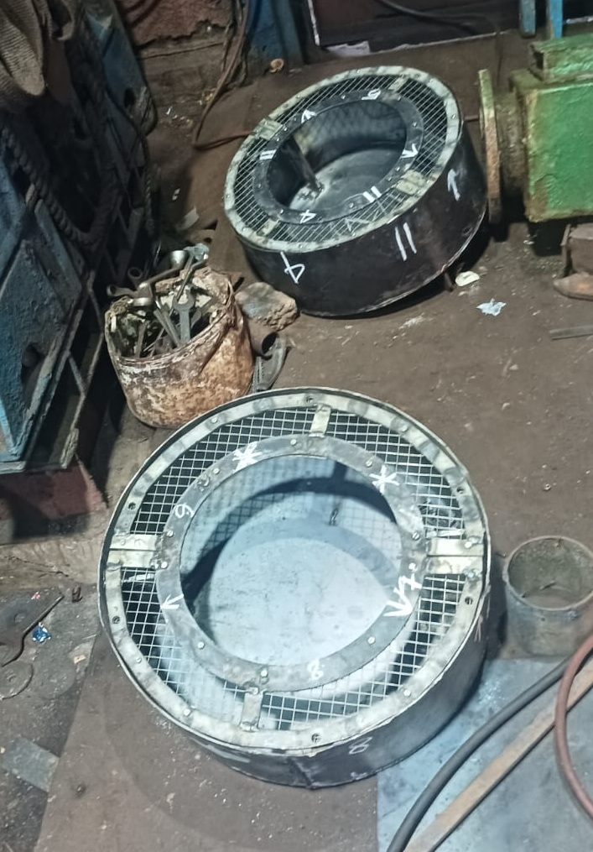
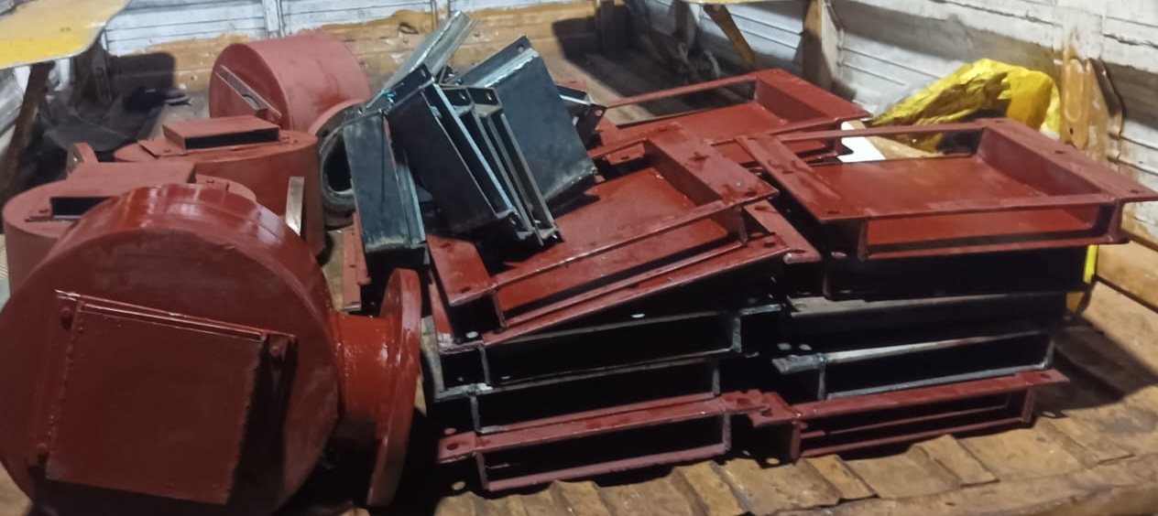
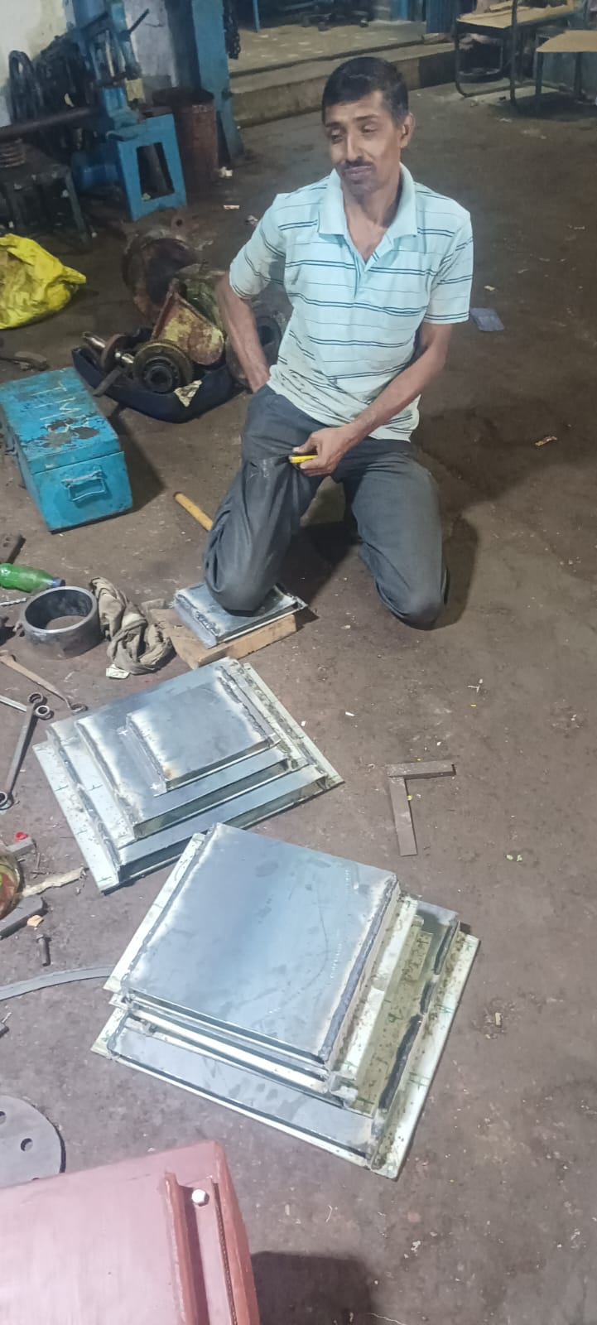
Additional Ventilation Components
Face Plates Manufactured
Mushroom Vent Heads
30 units at 300 x 170 mm
2 sets at 570mm diameter
30 units at 220 x 120 mm
2 sets at 715mm diameter
Various sizes for different locations
All fitted in position by workshop team

Slide 5
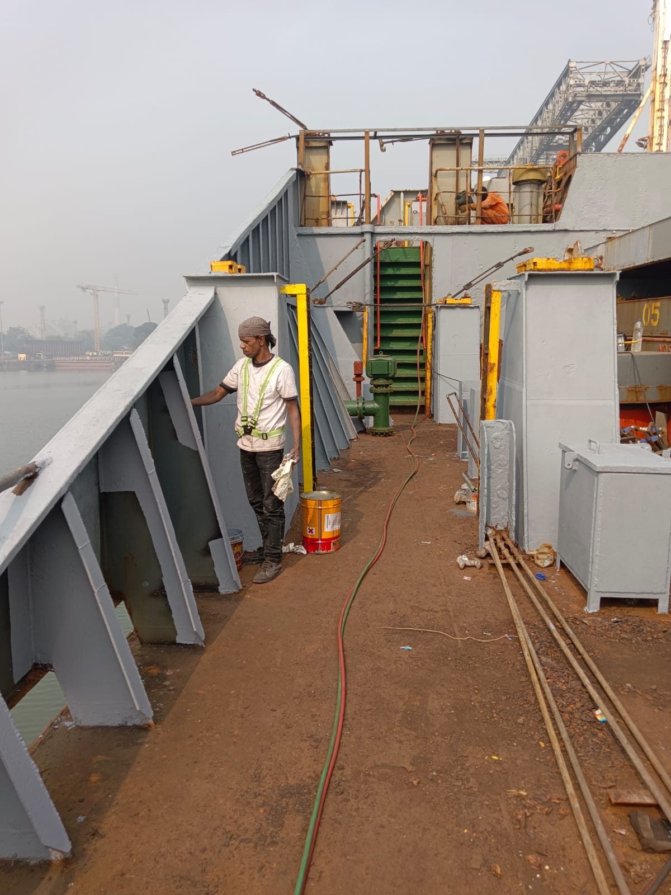
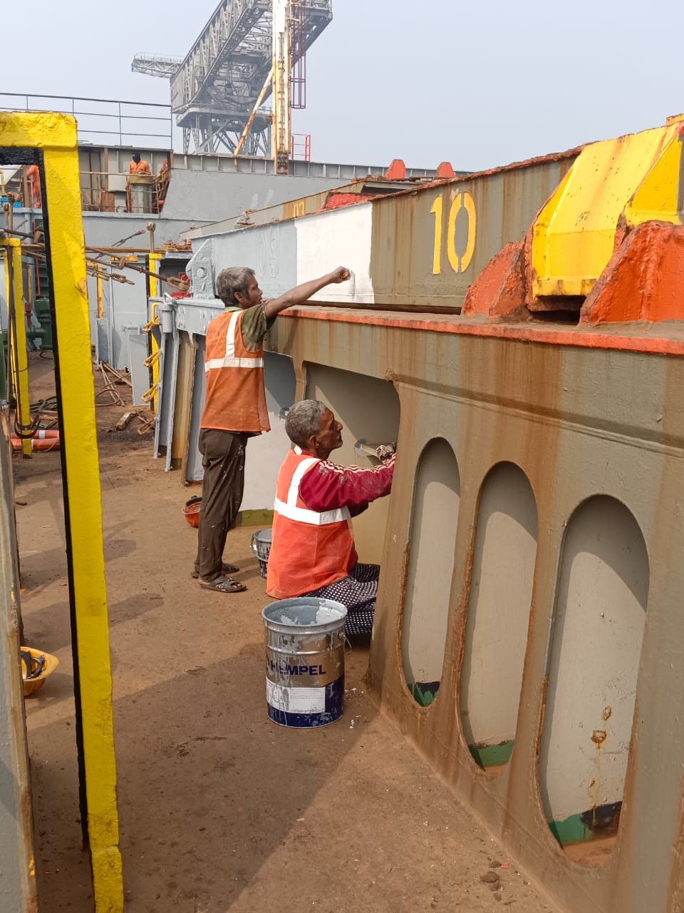
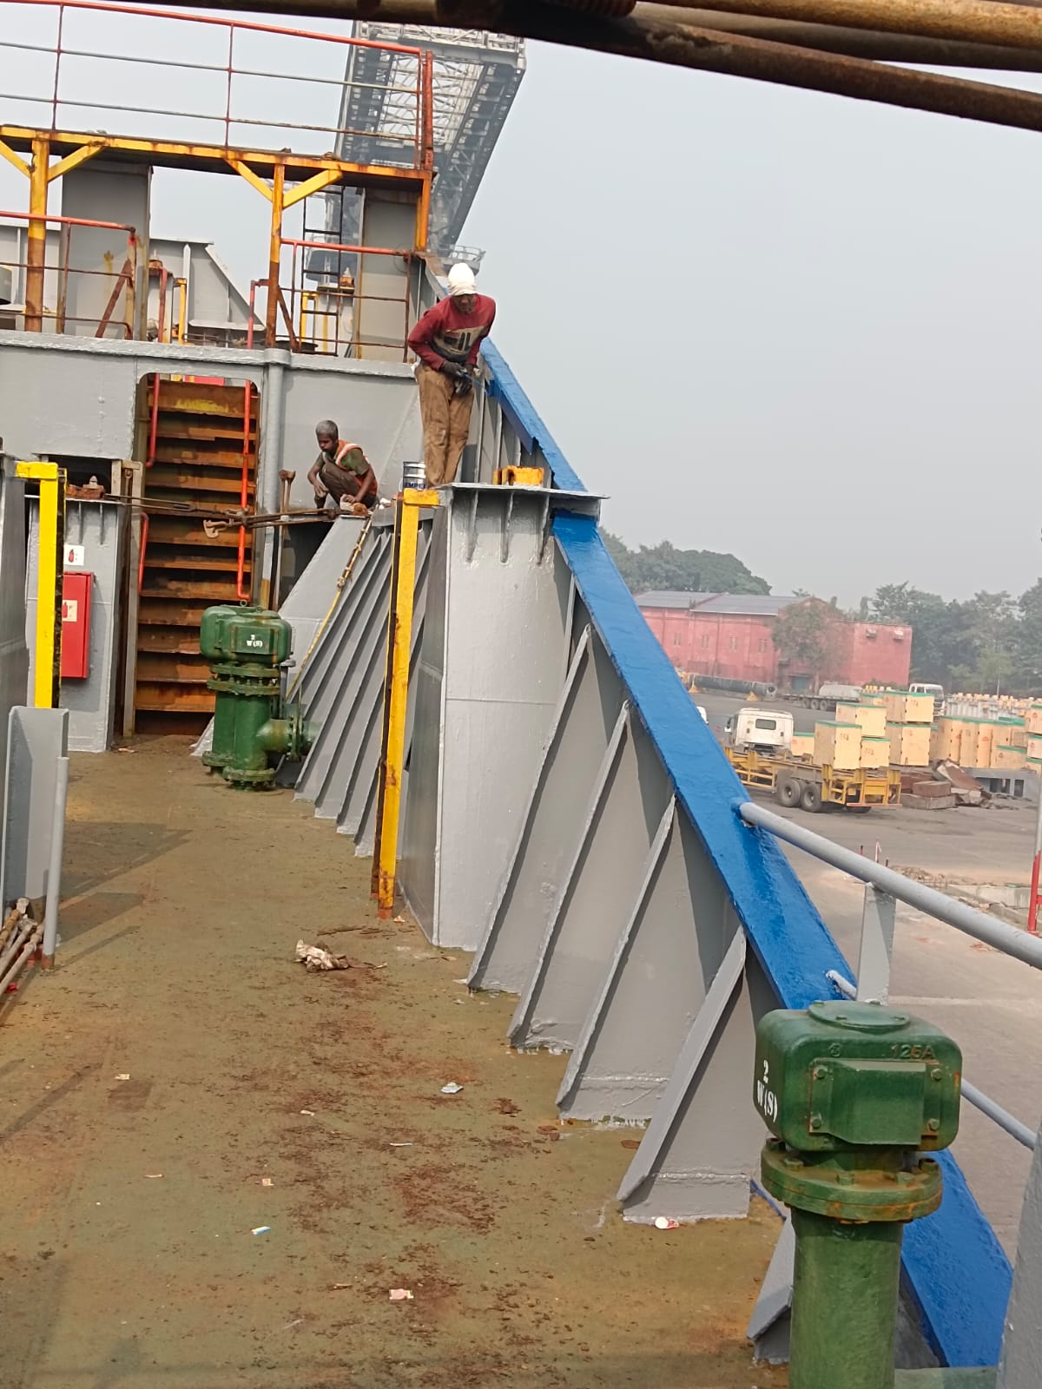



Comprehensive Deck Painting Operations
Complete deck surface preparation and painting from aft to forward, including all pipelines and container shoe boxes. Operations performed with meticulous attention to surface preparation through chipping and cleaning before paint application.
Surface Preparation
Pipeline Treatment
Container Areas
Chipping and cleaning all deck surfaces
Complete coating of deck pipelines
Shoe box painting completed

Slide 6
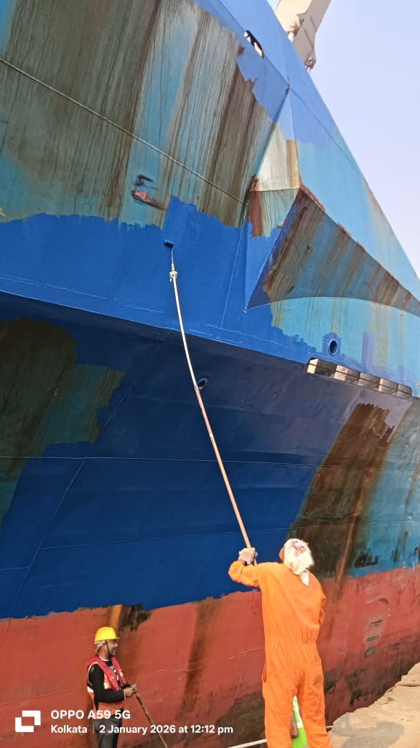
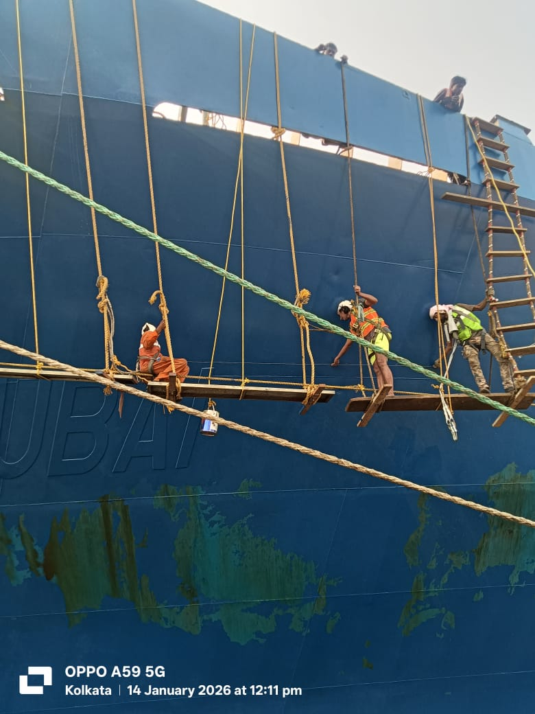


Emergency Side Shell Painting Project
148.3
22.9
Ship Length (Meters)
Ship Breadth (Meters)
Width of painting coverage area
Urgent side shell painting executed above load line to deck level. Starboard side from cargo hold no. 2 to aft side shell completed. Port side painting progressed from aft to Bay No. 26 with accommodation area finished. Aft side slant plate completed during this period.

Slide 7
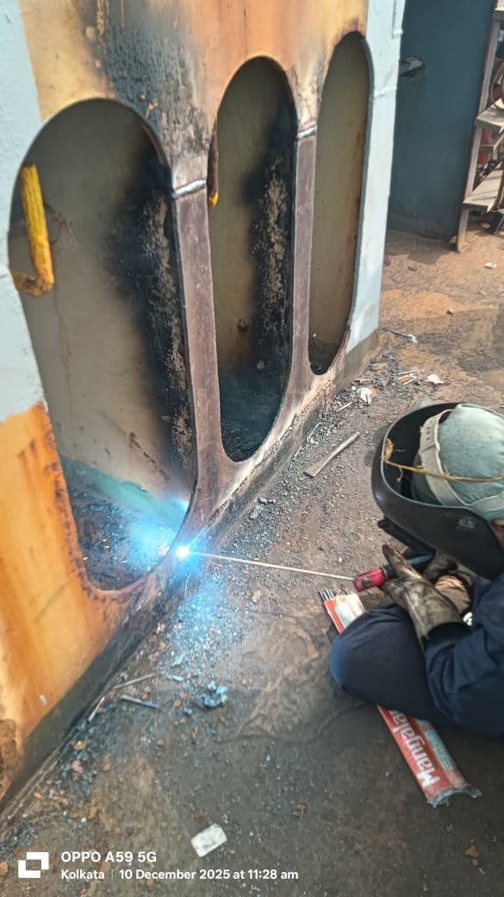
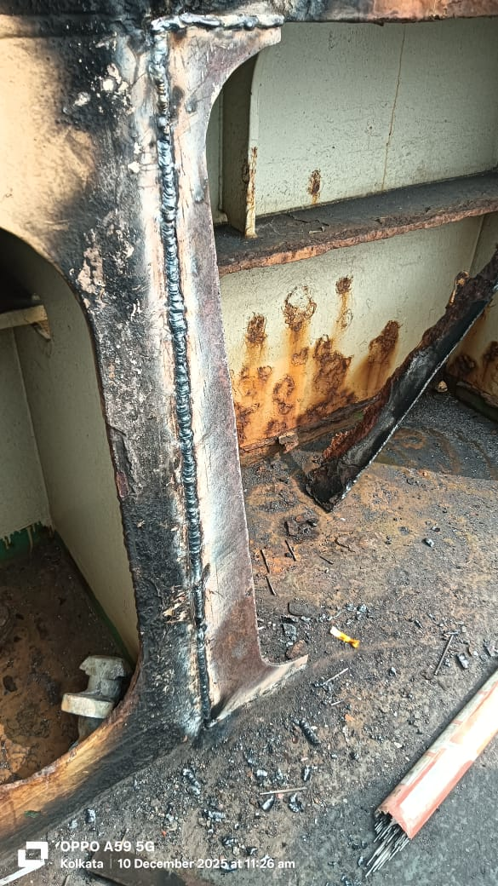
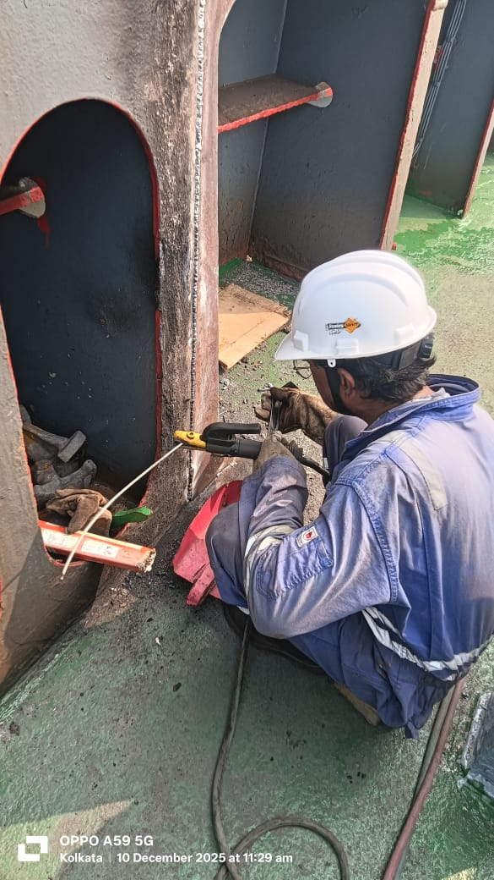
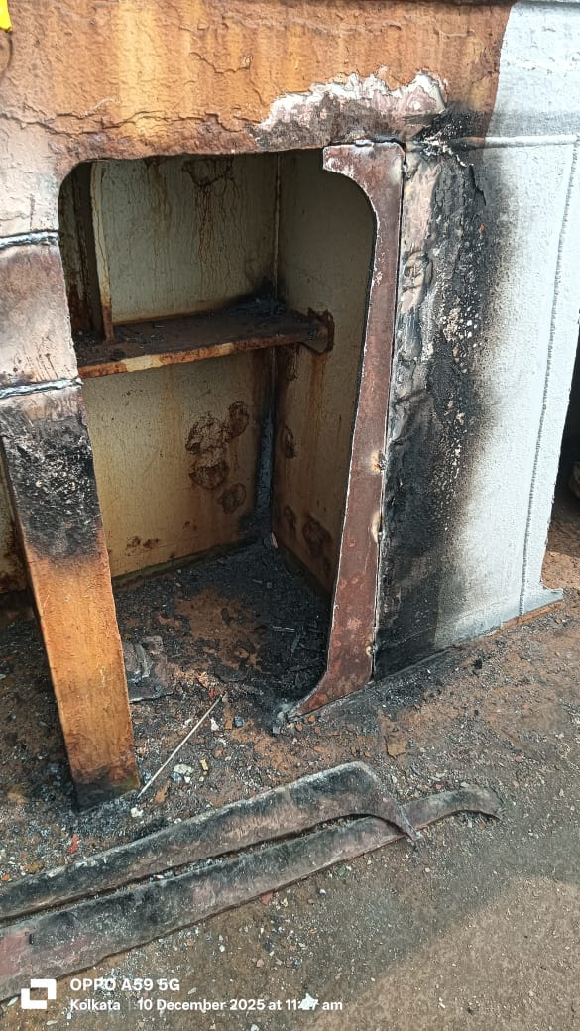



Structural Repairs on Deck
Port Side Forward Stiffener
Bay 10 Starboard Platform
Bay 26 Fashion Plates
Cropped and renewed structural component
Complete replacement executed
Aft fashion plates cropped and renewed
Critical structural repairs performed to maintain vessel integrity and safety standards. All work completed with precision welding and quality verification.

Slide 8
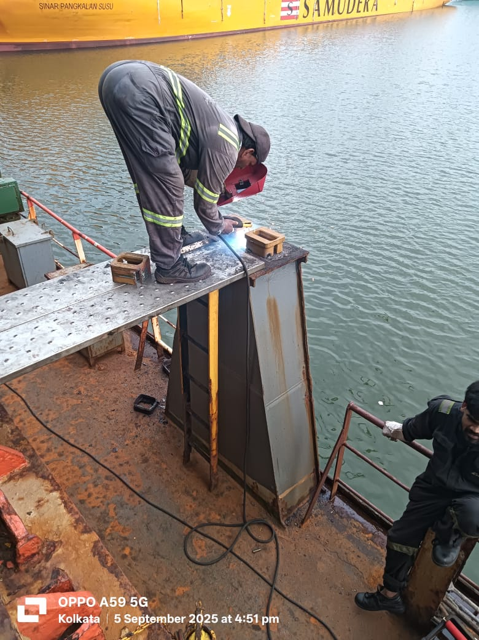
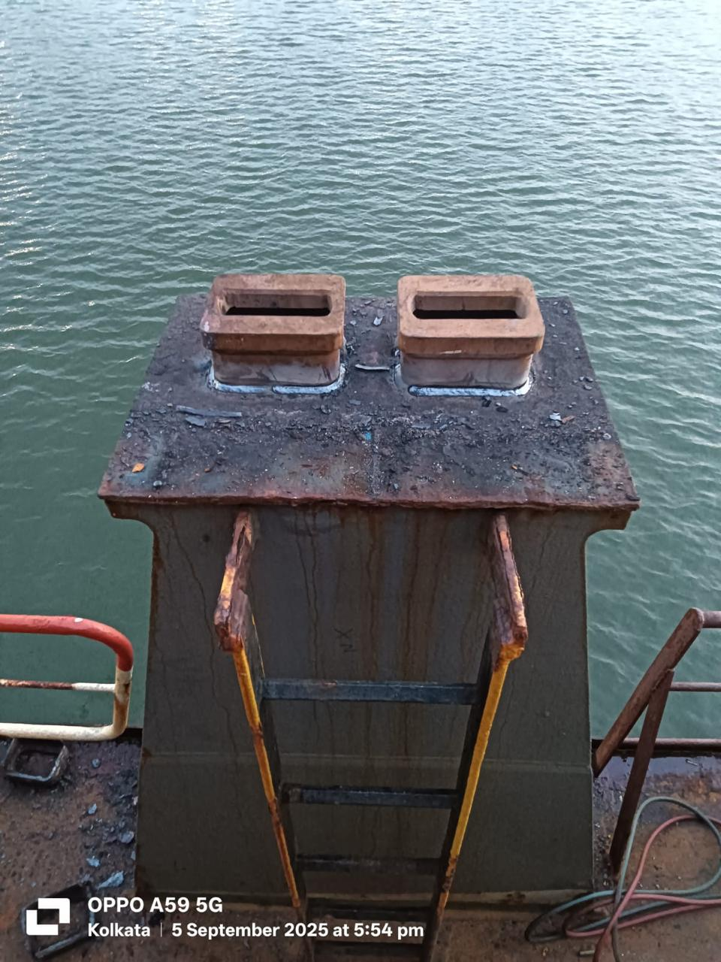
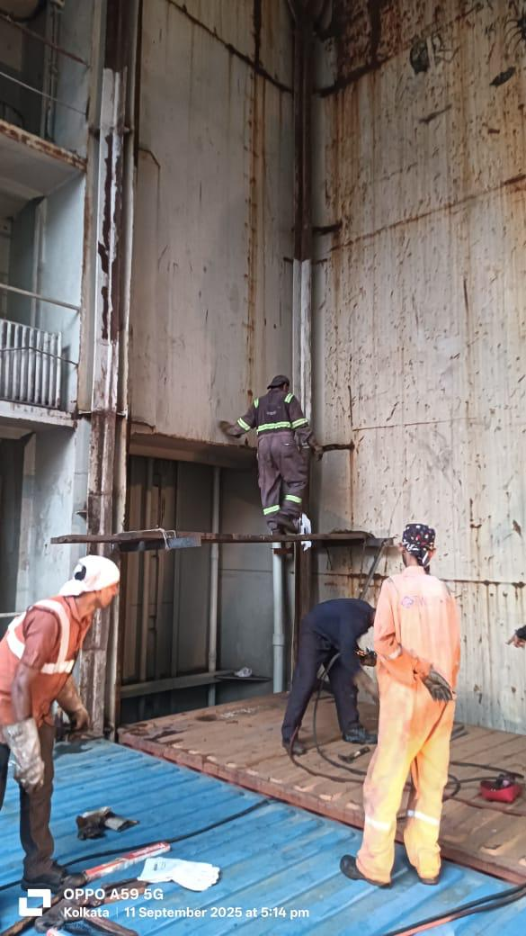
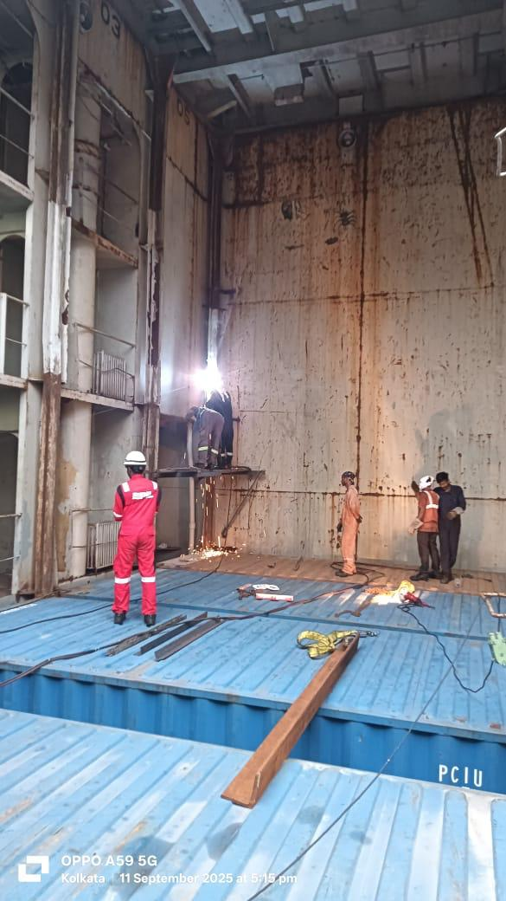
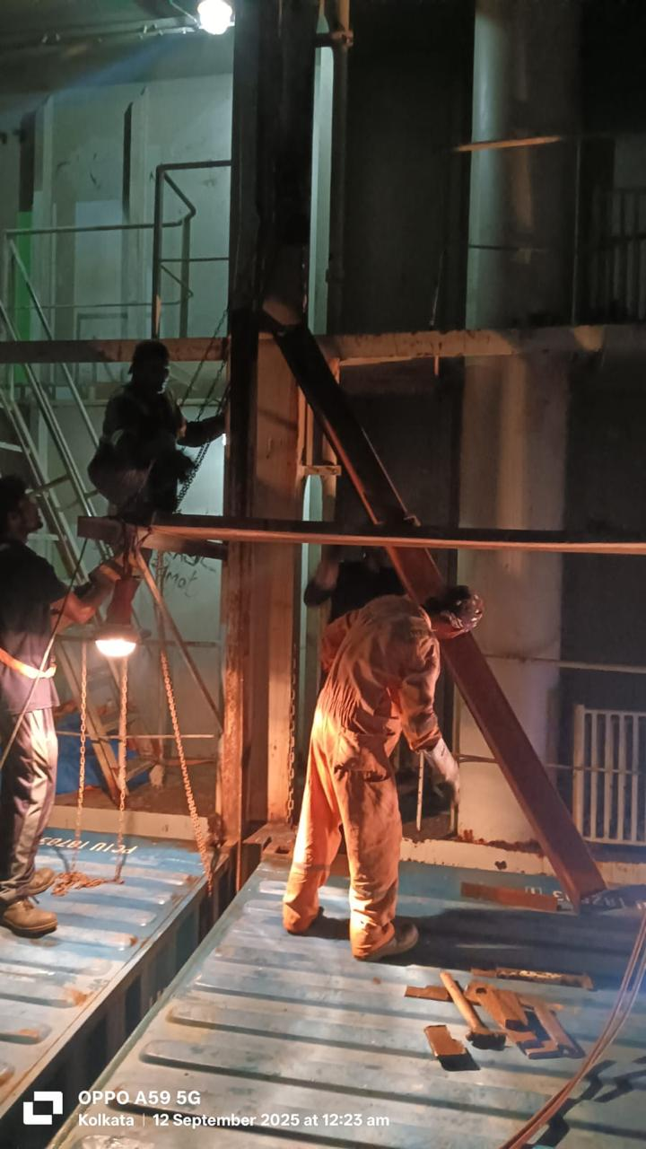
Cell Guide Renewals
TOTAL LENGTH RENEWED 32.8 MTRS
Containers' ISO Sockets Renewal

Slide 9
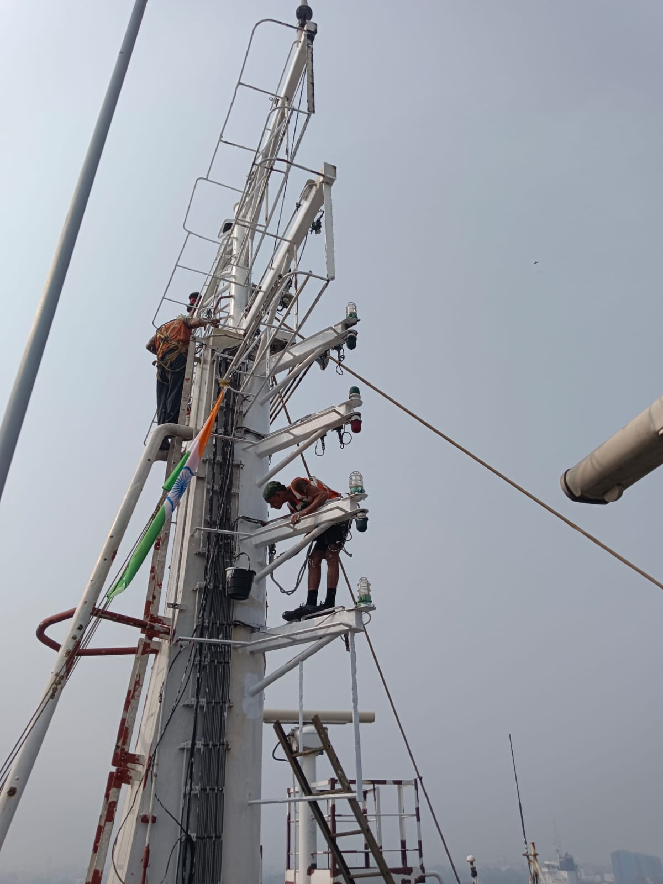
DECEMBER 7-10, 2025
December Maintenance Period Overview
Second maintenance period focused on extensive painting operations, crane safety installations, and structural repairs. Work included paint room watertight door repairs and comprehensive surface treatment across multiple deck locations.
01
02
Deck Items Treatment
Mast House Painting
Port and starboard pedestal areas
Top of monkey island completed
03
Forecastle Deck
Extreme forward area finished

Slide 10
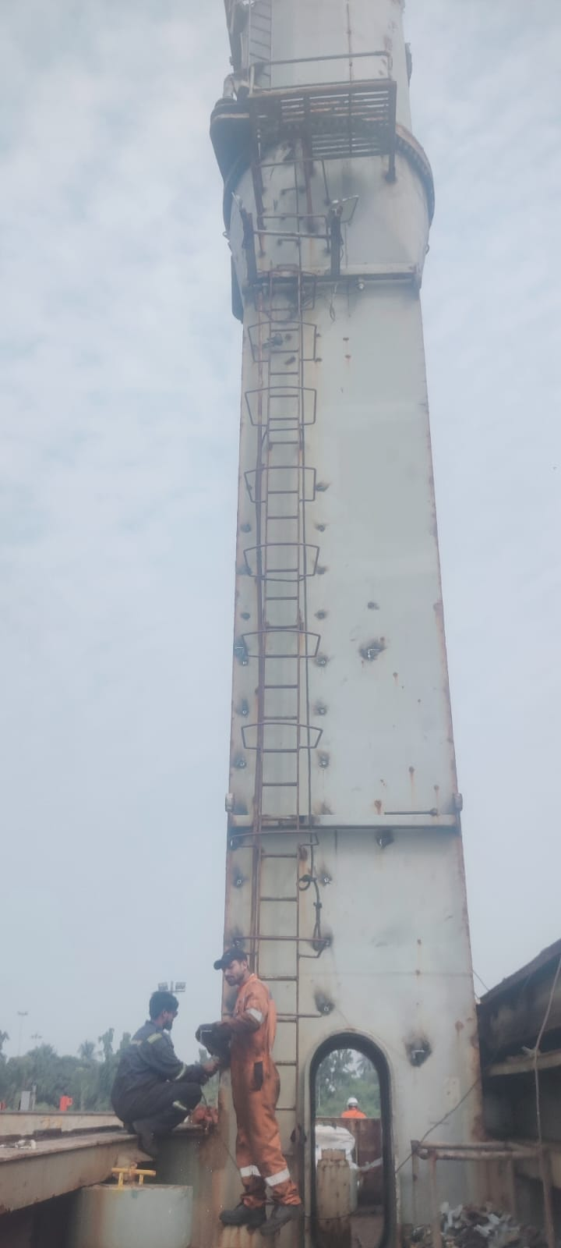
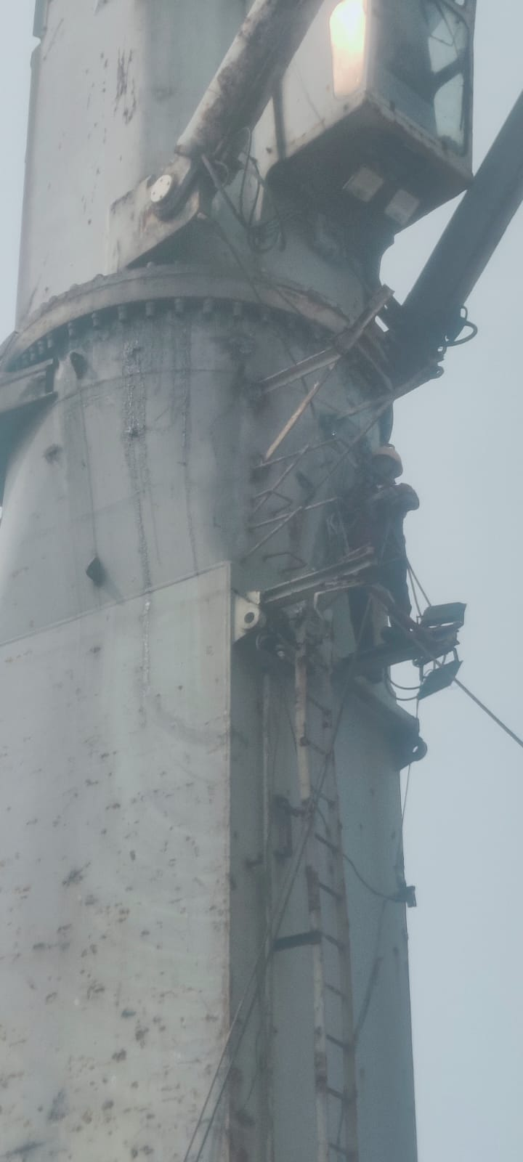
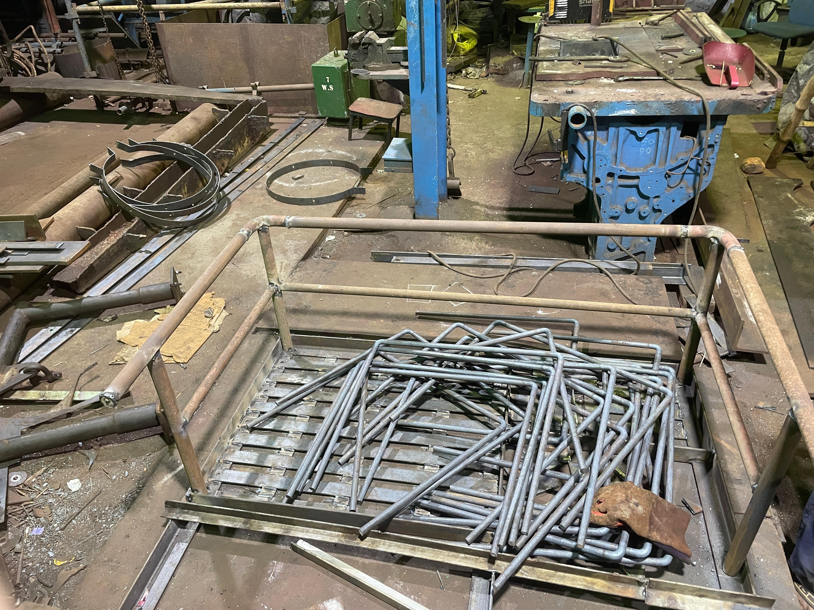
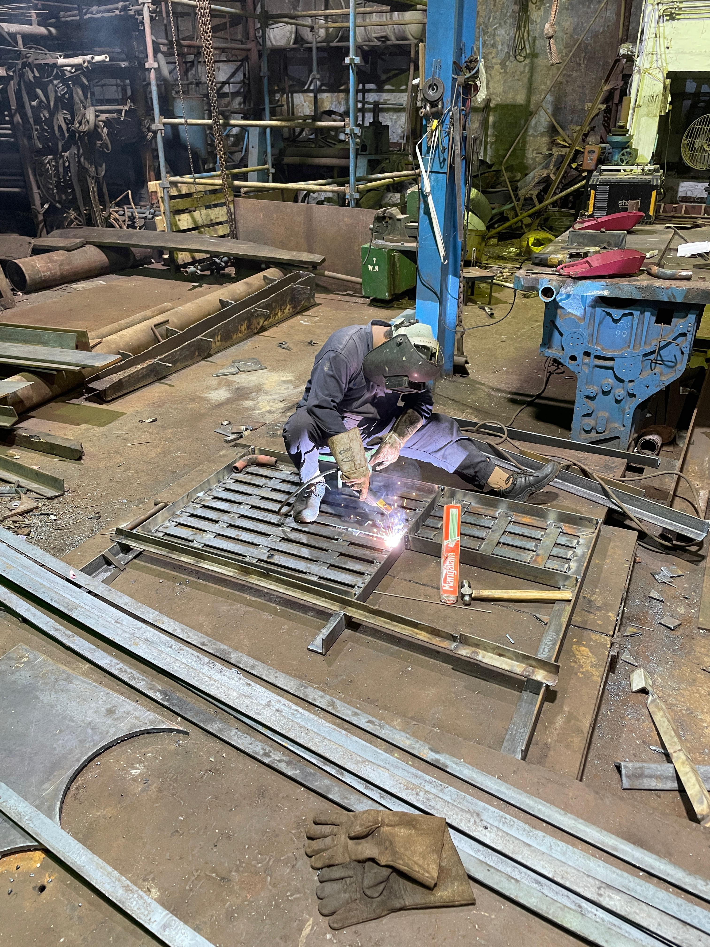
Crane Safety Guard Installation
Fabrication and installation of 40 ladder guards for Cranes No. 1 and No. 2, performed as work at height. Pre-fabricated at workshop using MS Round 20mm diameter in "C" shape configuration, measuring 600 x 700 x 600mm. All guards transported onboard December 6, 2025 and professionally fitted.

Slide 11
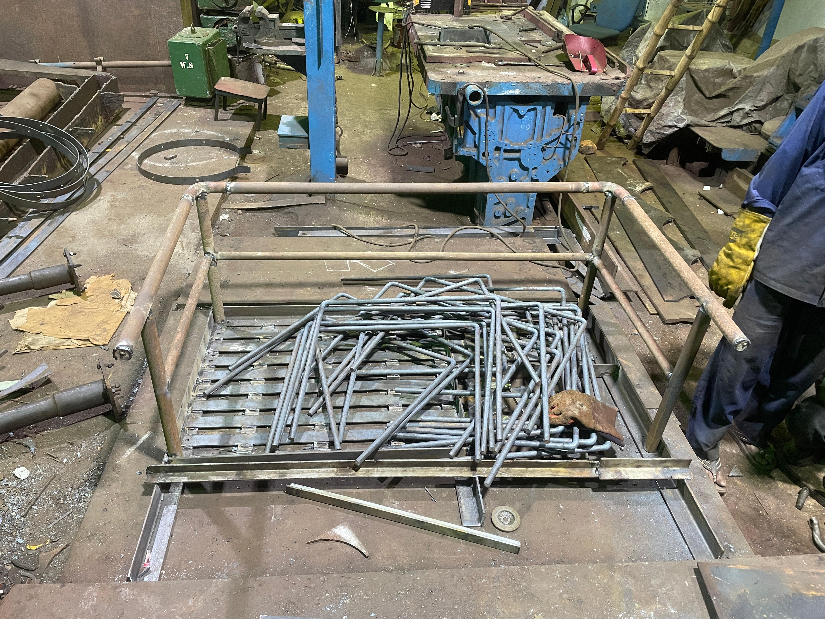
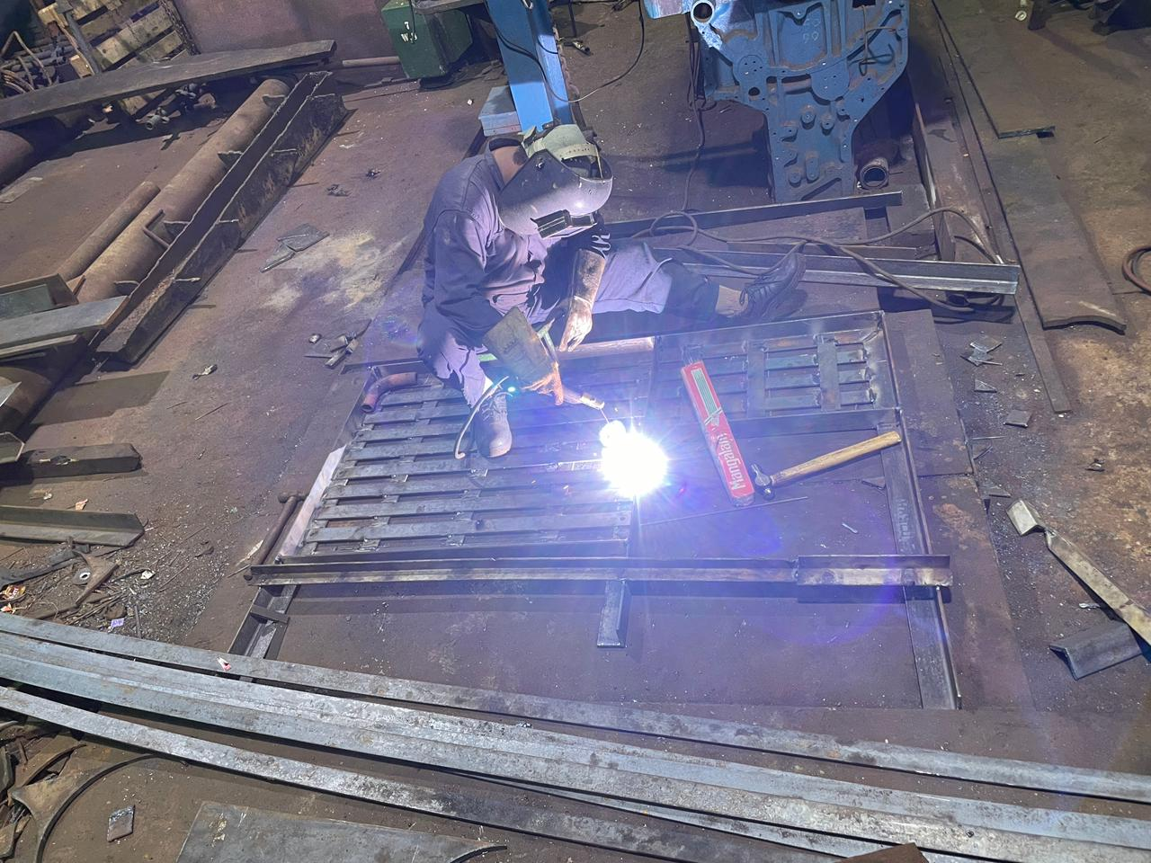
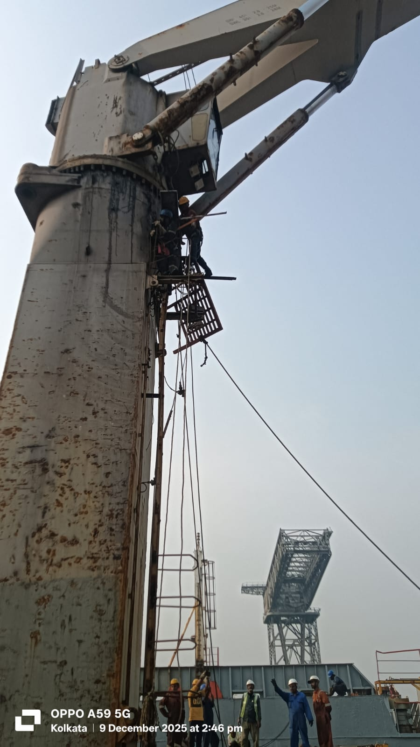
Crane No. 1 Platform Replacement
Materials Used
MS Seamless Pipe 40NB x 9040mm x 2 bends
MS Flat Bar 6 x 50 x 13045mm
Complete platform pre-fabricated at workshop using supplied materials. Staging erected for safe access, old corroded platform removed by gas cutting, and new platform installed and secured. All work at height performed with proper safety protocols.
MS Angle 8 x 75 x 75 x 11300mm
MS Brackets in various sizes

Slide 12
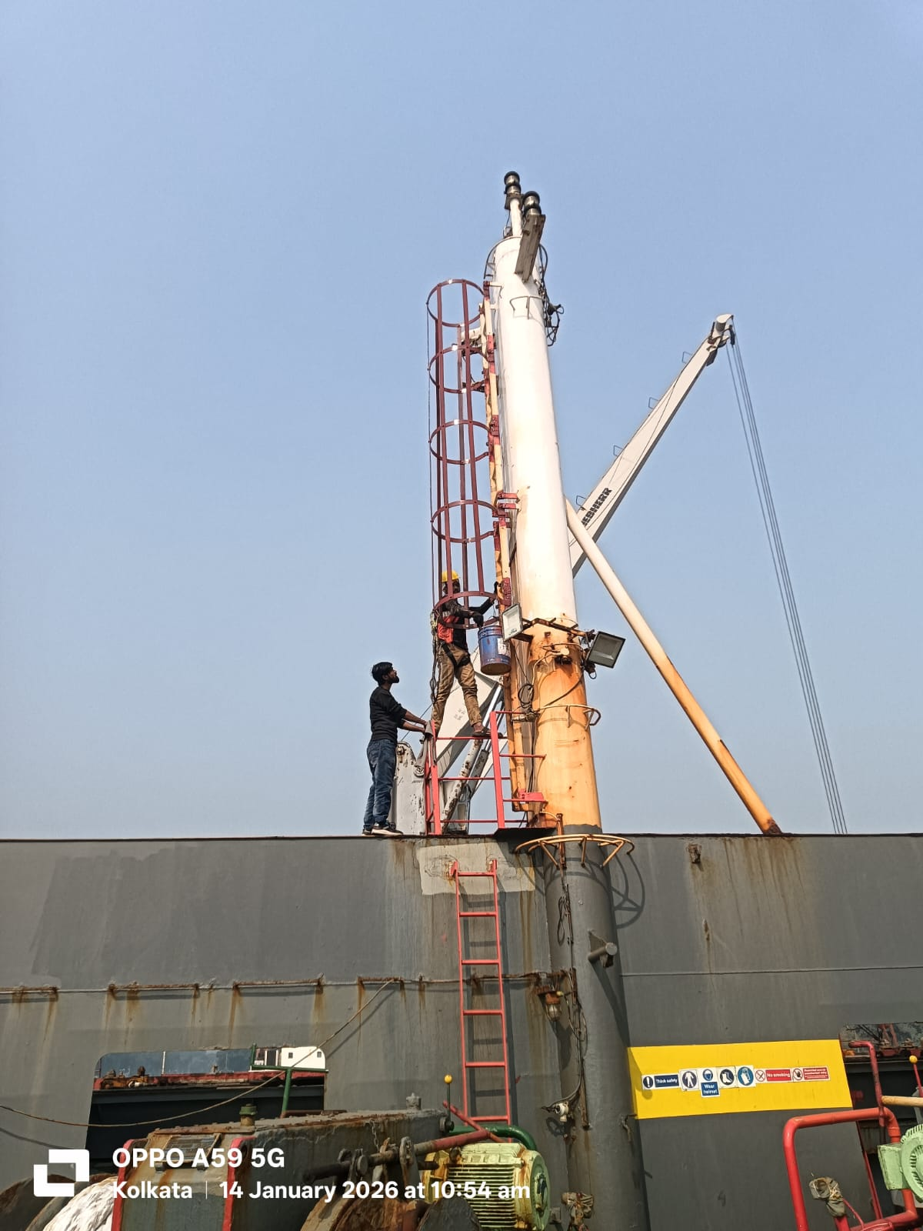
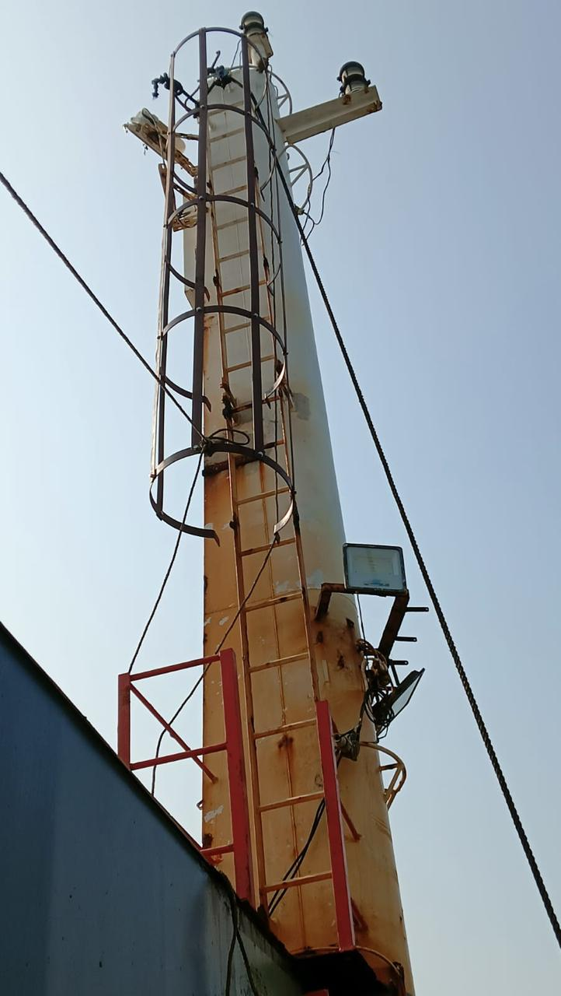
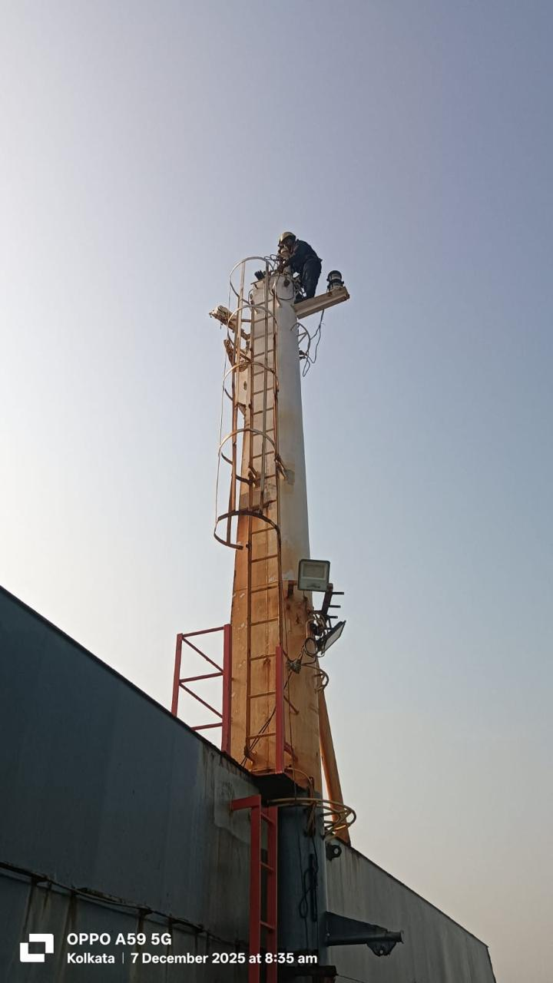
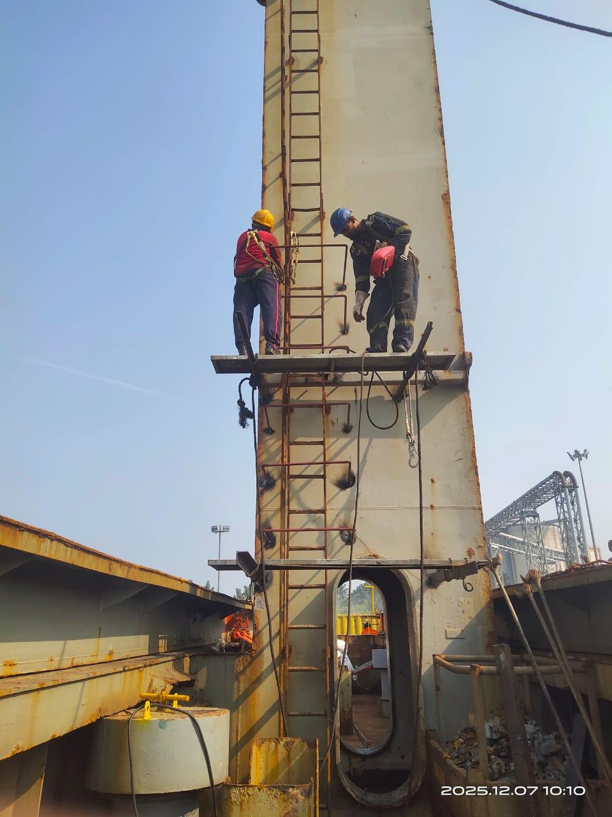
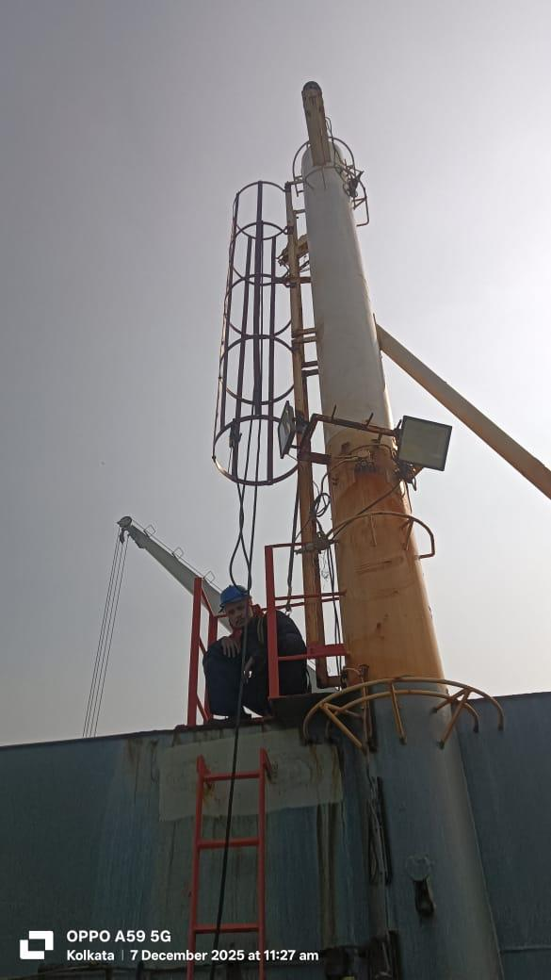



Forward Mast House Crane Ladder Safety Guards
Five ladder safety guards fabricated and installed on forward mast house cranes. Manpower deployed during previous Kolkata call to obtain precise measurements. Guards pre-fabricated at workshop using MS Flat Bar 6 x 50mm in round and straight configurations, secured with 30 stainless steel M10 x 25mm bolts and nuts.
Measurement Phase
Precise sizing during previous call
Workshop Fabrication
Pre-manufactured components
Onboard Installation
Staging and fitting completed

Slide 13
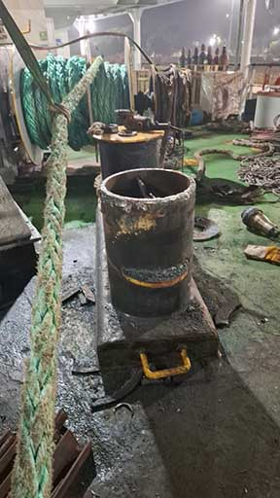
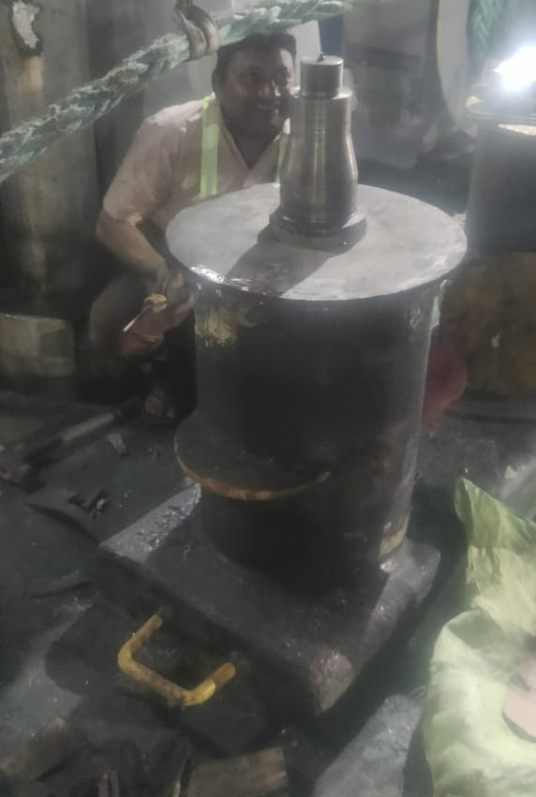
Bollard Bitts Renewal Project
Five bollard bitts with wasted top plates required complete replacement. Workshop fabricated new components using MS Plate 12mm thickness x 610mm diameter. Onboard operations involved gas cutting damaged bollard bitts and welding new fabricated units in place. All work inspected and approved by ship staff.

Slide 14
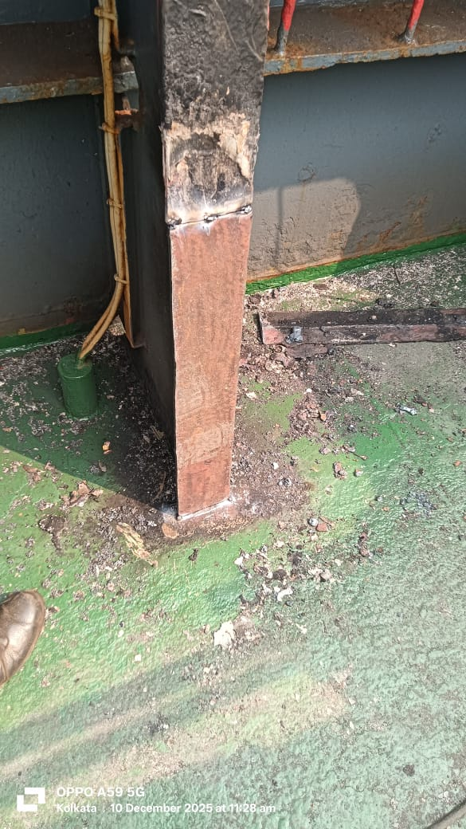
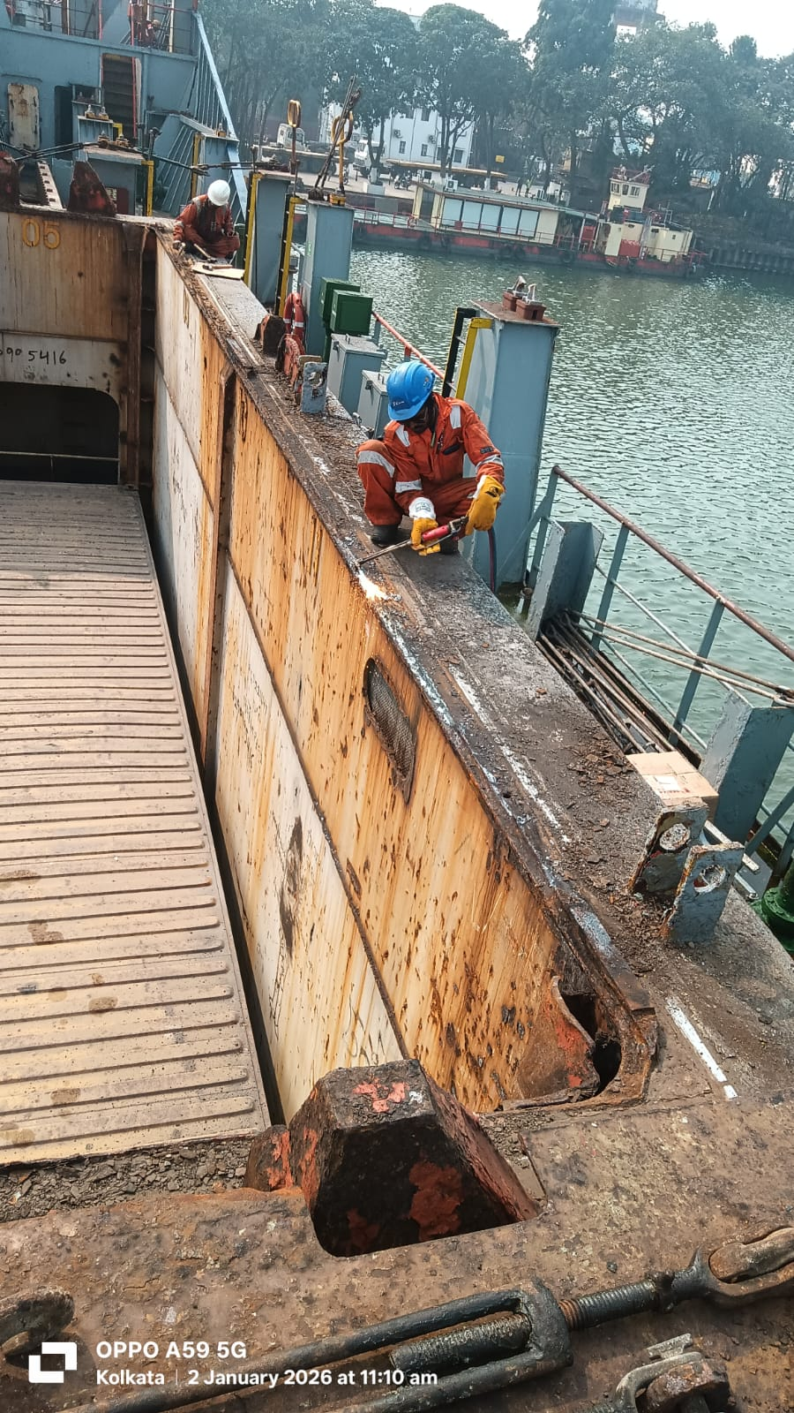
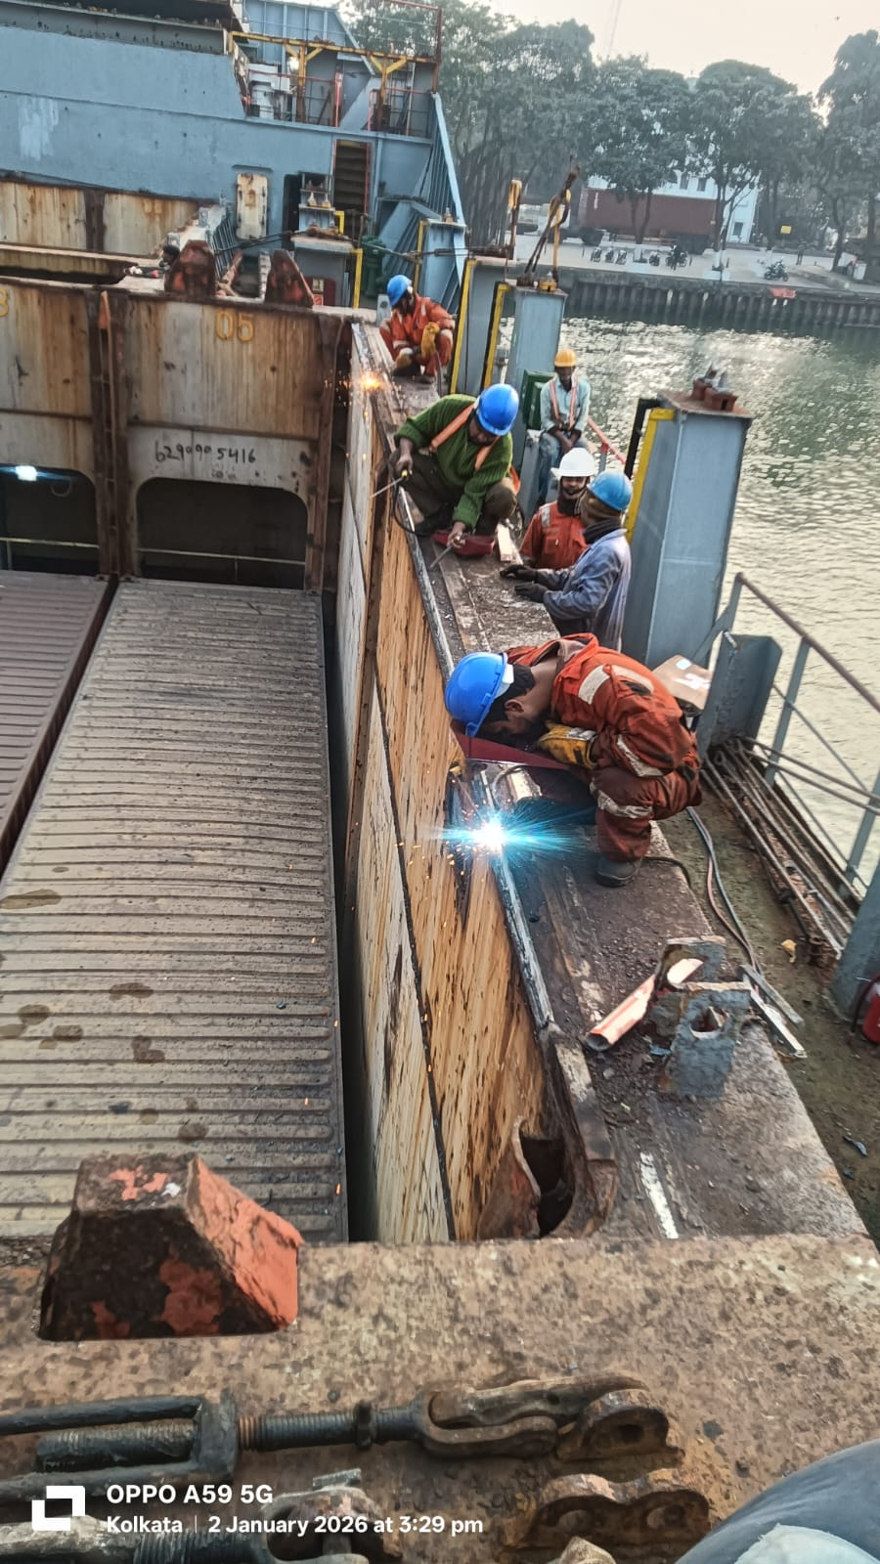
Cargo Hold Structural Repairs
Stiffener Plate Renewal
Seal Coaming Plate
Port and starboard wasted stiffener plates cropped and renewed at various locations using 12mm thick x 600mm x 125mm plate
No. 1 cargo hold seal coaming plate and compression bar completely renewed after extensive gouging. Total length: 7,250mm using 12mm thick x 40mm material

Slide 15
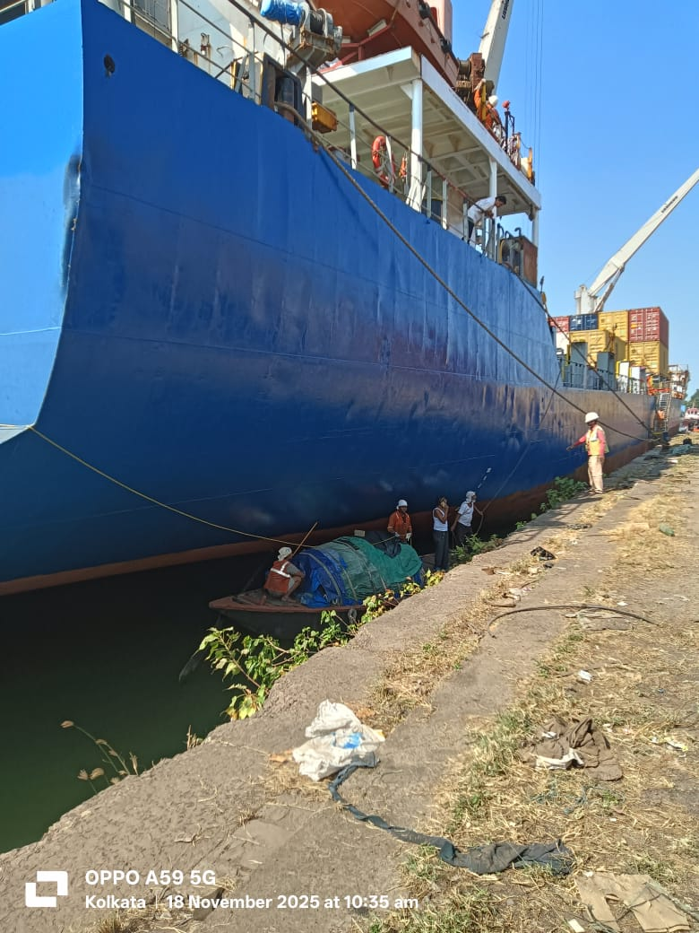
Extended Side Shell Painting Coverage
Comprehensive painting operations above load line to deck level covering ship's full dimensions of 148.3 meters length by 22.9 meters breadth. Blue color applied throughout all completed sections.
Forward Starboard Side
From cargo hold no. 2 to anchor hawse and spurling pipe exterior
Forward Bulwark Area
Starboard to port side extending to cargo hold no. 2
Aft Transom Area
Complete area above sloping plate
Aft Port Accommodation
Bulwark area fully treated

Slide 16
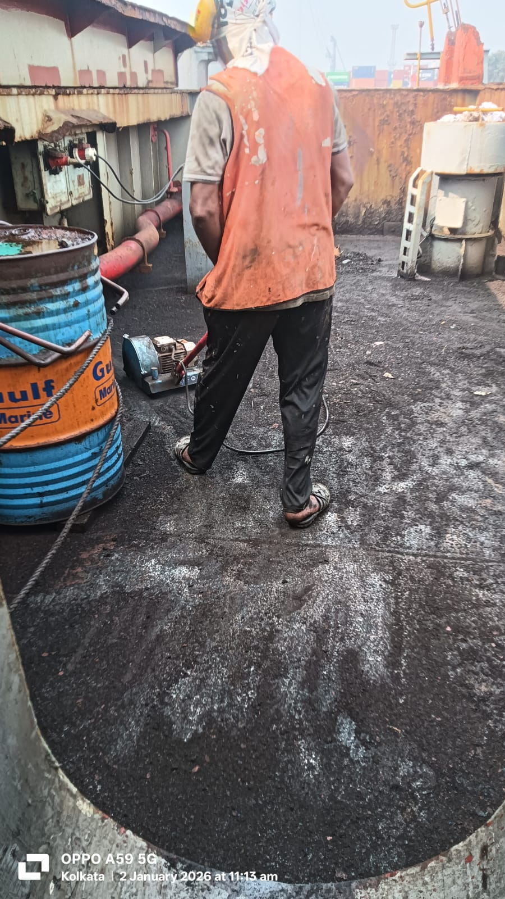
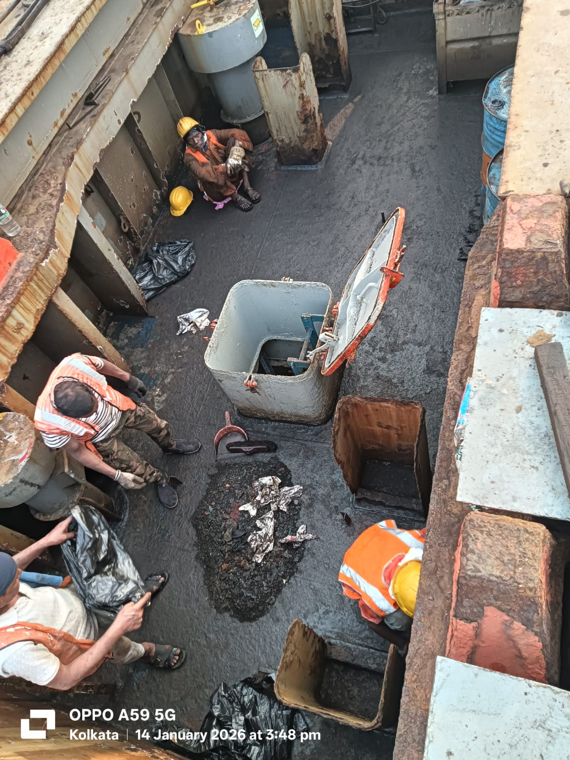
JANUARY 1-3, 2026
New Year Maintenance Operations
De-rusting and painting operations focused on upper deck forward and accommodation block areas. All work performed using ship-supplied paints with comprehensive surface preparation.
Areas Completed
No. 1 Crane cross deck area (port and starboard)
Forward forecastle deck port side
Hatch cover stiffeners
Complete treatment to cargo hold no. 2

Slide 17
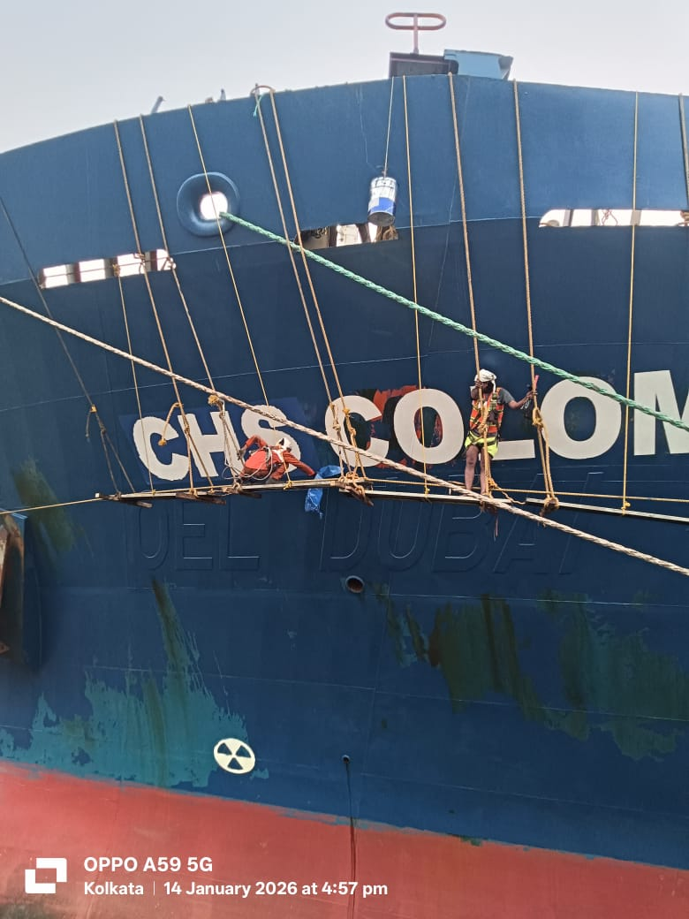
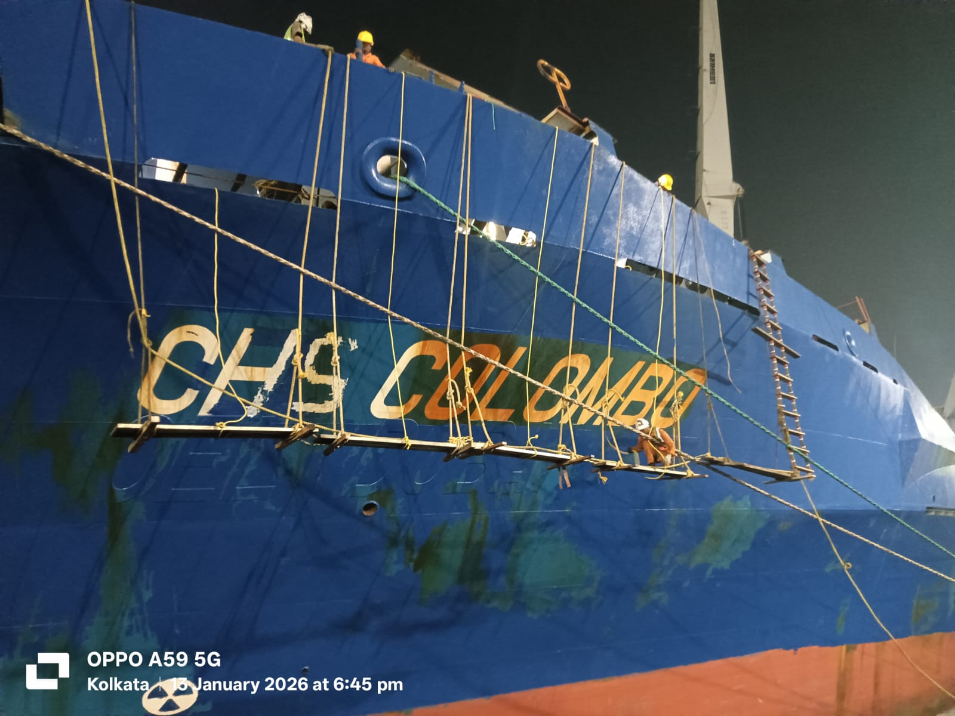
JANUARY 13-14, 2026
Ship's Name Painting Project
Professional ship's name painting executed using stencil sticker method with staging for safe access. Forward port side ship's name painting completed during this period. Balance of work scheduled for completion during next port call.

Slide 18
Project Timeline Overview
November 16-18, 2025
January 1-3, 2026
Ventilation systems and initial painting
Upper deck de-rusting and painting
1
2
3
4
December 7-10, 2025
January 13-14, 2026
Crane safety and structural repairs
Ship's name painting operations

Slide 19



Quality Assurance & Verification
Ship Staff Inspection
Safety Compliance
Workshop Standards
All completed jobs thoroughly checked by ship staff personnel and found satisfactory, meeting required standards and specifications.
Work at height operations performed with proper staging, safety equipment, and protocols throughout all maintenance periods.
Pre-fabrication at workshop ensured quality control and efficient onboard installation with minimal vessel downtime.

Slide 20
Key Achievements Summary
Ventilation Systems
Complete overhaul of water ballast tank air vent heads and mushroom vents with 107 total components fabricated and installed
Safety Enhancements
45 ladder safety guards installed across crane systems, significantly improving crew safety during operations
Structural Integrity
Critical repairs to stiffeners, platforms, fashion plates, bollard bitts, and cargo hold components ensuring vessel seaworthiness
Protective Coatings
Extensive painting operations covering 3,395 square meters of side shell and deck surfaces above load line

Slide 21
Project Completion & Next Steps
M.V. CHS Colombo maintenance and repair operations successfully executed across four distinct periods, delivering comprehensive improvements to vessel safety, structural integrity, and protective systems. All work completed to specification with ship staff approval.
01
02
Completed Work
Pending Items
All scheduled maintenance and repairs finished satisfactorily
Port side painting balance and ship's name completion scheduled for next call
03
Documentation
Complete records maintained for all fabrication, installation, and painting operations

